Slide 1
Sorting Algorithms –II
Quick Sort
Instructor : Shekh. Md. Saifur Rahman

Slide 2
Divide & Conquer (revisited)

Slide 3
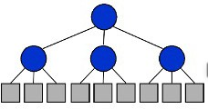
Divide-and-Conquer Technique
Divide-and-Conquer is a general algorithm design paradigm:
Divide the problem into a number of subproblems that are smaller
instances of the same problem
Conquer the subproblems by solving them recursively
Combine the solutions to the subproblems into the solution for the
original problem
The base case for the recursion are subproblems of constant size
Analysis can be done using recurrence equations

Slide 4
Quick Sort

Slide 5
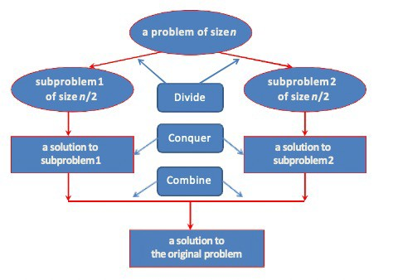
Divide-and-Conquer

Slide 6
Merge Sort and Quick Sort
Two well-known sorting algorithms adopt this divide-and-conquer strategy
Merge sort
Divide step is trivial – just split the list into two equal parts.
Work is carried out in the conquer step by merging two sorted lists.
Quick sort
Work is carried out in the divide step using a pivot element.
Conquer step is trivial.

Slide 7
Quick Sort
Another divide-and-conquer algorithm
The array A[p..r] is partitioned into two non-empty subarrays A[p..q] and A[q+1..r]
p
q
q+1
r
8 | 15 | 4 | 30 | 25 | 7 | 18 | 12
8 | 4 | 7 | 12 | 15 | 30 | 25 | 18
Invariant: All elements in A[p..q] are less than all elements in A[q+1..r]
The subarrays are recursively sorted by calls to quicksort
Unlike merge sort, no combining step: two subarrays form an already-sorted array

Slide 8
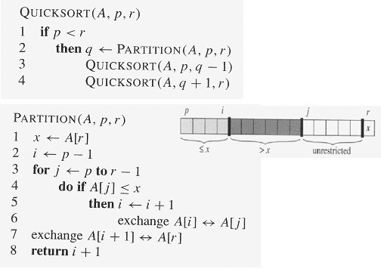
Quick Sort

Slide 9
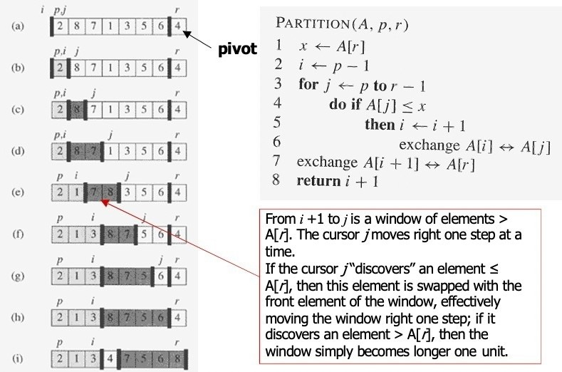

Slide 10
Quick Sort (Partition)
Clearly, all the actions take place in the partition()function
Rearranges the subarrays in place
End result:
Two subarrays
All values in first subarray | pivot | all values in the second subarray
Returns the index of the “pivot” element separating the two subarrays

Slide 11
Quick Sort (Analysis)
What will be the worst case for the algorithm?
Partition is always unbalanced
What will be the best case for the algorithm?
Partition is perfectly balanced
Which is more likely?
The partition is almost balanced …
Will any particular input elicit the worst case?
Yes: Already-sorted input

Slide 12
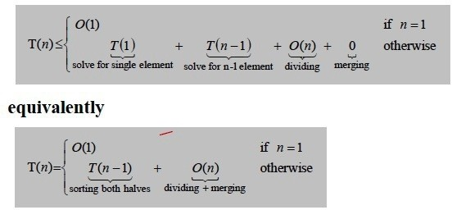
Quick Sort: Worst case running time
The recurrence for the worst-case running time T(n) is [Partition is always unbalanced]

Slide 13
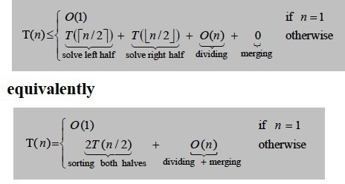
Quick Sort: Best case running time
The recurrence for the best-case running time T(n) is [Partition is always balanced]

Slide 14
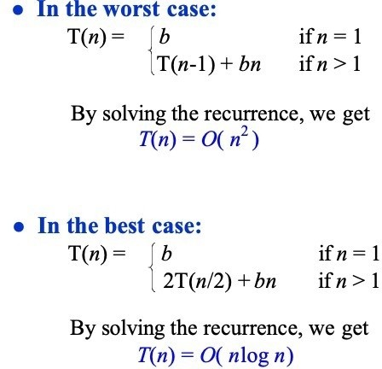
Quick Sort: Running Time

Slide 15
Quick Sort: Analysis
The real liability of quicksort is that it runs in O(n²) on already-sorted input Two solutions:
Randomize the input array, OR
Pick a random pivot element
How will these solve the problem?
By ensuring that no particular input can be chosen to make quick-sort run in O(n²) time
Assuming random input, average-case running time is much closer to O(nlog n) than O(n²)

Slide 16
Thank You

